Slide 1

Application of Machine Learning Classifiers for Predicting the Outcome of Bank Telemarketing
Student: Samuel Ogbonnaya
Supervisor: Professor Eleni Vasilaki
Assessor: Professor Roger Moore

Slide 2
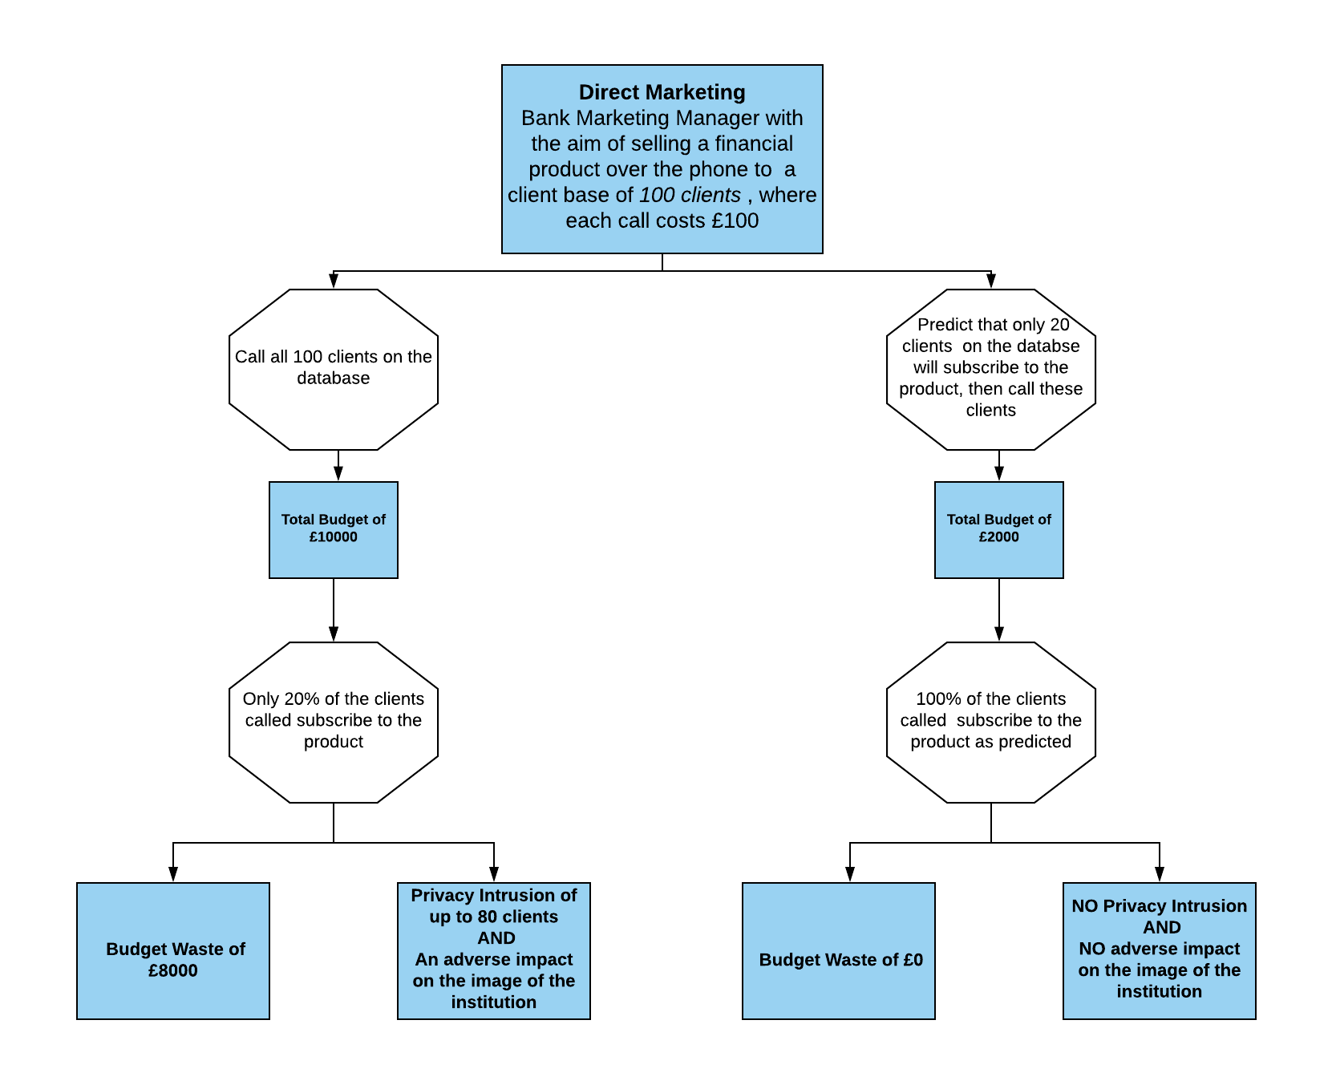
Bank Telemarketing Classification Problem
Without Machine Learning = Ineffective & Costly
With ‘Ideal’ Machine Learning = Effective & Cost Efficient

Slide 3
The Machine Learning Landscape
What is Machine Learning?
Field of study that gives computers the ability to learn from data without being explicitly programmed.
It can be applied to a variety of different problems in different industries such as Finance, Retail, Medicine etc.
Types of Machine learning based on methods of learning:
Supervised Learning – utilizes ‘labelled’ data (Logistic Regression, SVMs, Decision trees etc.)
Unsupervised Learning – utilizes ‘unlabelled’ data (K-means Clustering, PCA etc.)
Semi-Supervised Learning– combination of ‘labelled’ and ‘unlabelled’ data
What is the Bank Telemarketing Problem and how do you tackle it?
Goal is to predict if a client will ‘subscribe’ or ‘not subscribe’ – this is a Classification problem
Type of machine learning algorithm employed will depend on the data used i.e. labelled or unlabelled data.

Slide 4
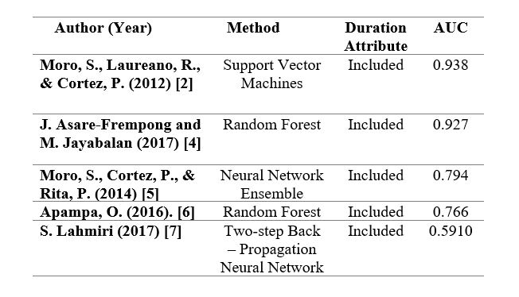
Current Climate of Bank Telemarketing Machine Learning Research?
A Portuguese retail bank conducted telemarketing campaigns between May 2008 and November 2010 and the outcome for each call was consolidated into what is known as the “Bank Telemarketing Dataset” available from the UCI Repository [1].
It consists of 20 input variables of client information and the outcome variable of ‘subscribe’ or ‘not subscribed’ – labelled, so therefore supervised learning algorithms.
The ‘not subscribed’ class is the majority class by a ratio of approximately 8:1 leading to an imbalanced dataset.
Surrounding research with this dataset have developed models using various machine learning algorithms to attempt to predict the outcome of a call.
This has been done using posterior variables which leads to unrealistic models [2].
In addition, most cases utilized the accuracy performance measure which has been established as an ineffective performance measure for imbalanced datasets [3].
C. Merz, P. Murphy, D. Aha,” Bank marketing Data Set” in UCI Machine Learning Repository, June, 2014.
S. Moro, P. Cortez and R. M. S. Laureano, “Enhancing bank direct marketing through data mining”, in proceedings of the 41st International Conference of the European Marketing Academy, 2012, pp. 1-8, May. 2012.
H. He and E. Garcia, “Learning from Imbalanced Data”, IEEE Transaction on Knowledge and Discovery, vol. 21, no. 9, pp. 1263-1281, Sept. 2009.
J. Asare-Frempong and M. Jayabalan, “Predicting Customer Response to Bank Direct Telemarketing Campaign”, 2017 International Conference on Engineering Technologies and Technopreneurship (ICE2T), Kuala Lumpur, Malaysia, pp. 1-4.
S. Moro, P. Cortez and P. Rita, “A Data-Driven Approach to Predict the Success of Bank Telemarketing”, Decision Support Systems, vol. 62, no. 1, pp. 22-13, Jun. 2014.
O. Apampa, "Evaluation of Classification and Ensemble Algorithms for Bank Customer Marketing Response Prediction", Journal of International Technology and Information Management, vol. 25, no. 4, pp. 85-100, 2016.
S. Lahmiri, “A two-step system for direct bank telemarketing outcome classification.”, Intelligent Systems in Accounting, Finance and management, vol. 24, pp. 40-55, 2017.

Slide 5
Project Motivation
In response to the research previously highlighted, the motivation behind my project was to:
Develop realistic models which do not utilize posterior variables and,
Evaluate the applied models using an effective performance measure
The combination of these two approaches brings novelty as there is little or no research investigating classifiers with this combination.
My project Aims and Objectives were as follows:
Investigating the performance of machine learning classifiers to predict if a bank client will subscribe without the use of posterior variables. This involved:
Identifying optimal feature sets for representing bank marketing data
Comparing the performance of parametric & non-parametric algorithms using an effective evaluation metric.
Investigating the effect of ensemble methods on improving algorithm performance. This involved:
Combining the classifiers evaluated in part 1 to create a new classifier with superior performance using Voting and Adaptive Boosting techniques
Therefore

Slide 6
Main Work Undertaken
Based on the literature review conducted and the linear separability of the dataset. The following parametric and non- parametric algorithms were applied and evaluated on the bank marketing dataset:
Parametric classifiers - Gaussian Naïve Bayes & Logistic Regression and,
Non-parametric classifiers- Decision Tree, Linear SVM & Multilayer Perceptron Artificial Neural Network
Implementation of ensemble methods which include:
Voting Classifier
Adaptive Boosting Classifier
Each model was:
Trained using Scikit-Learn Python Library
Optimized using grid-search and K-fold Cross -validation
Assessed for overfitting/underfitting using learning curves
Evaluated on the test set using the Area under the ROC curve as the main performance measure.

Slide 7
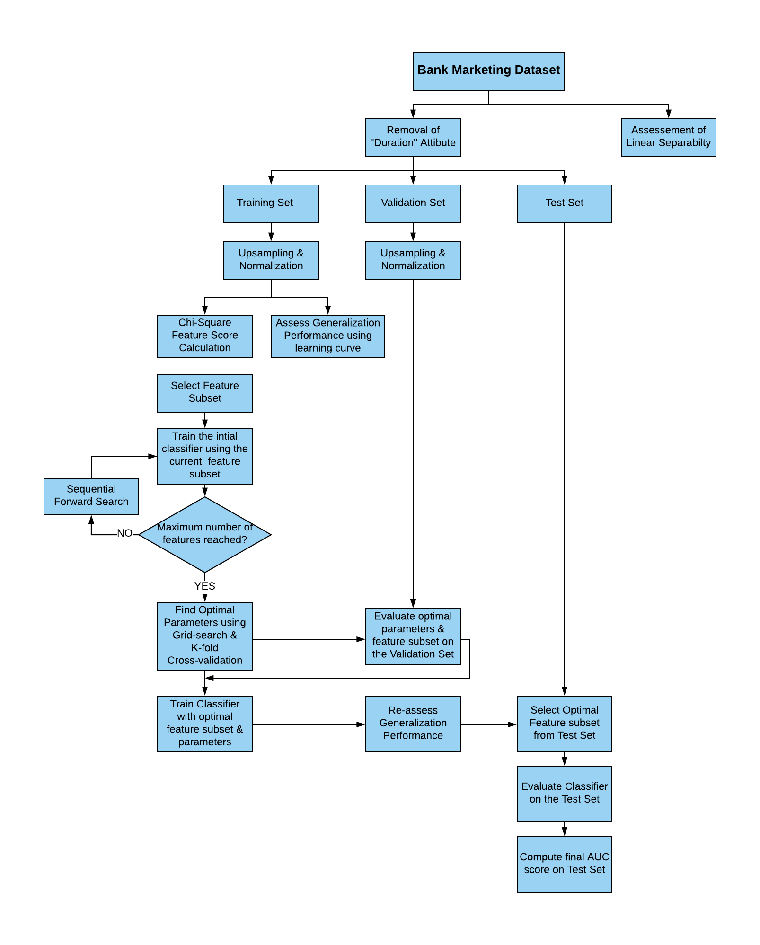
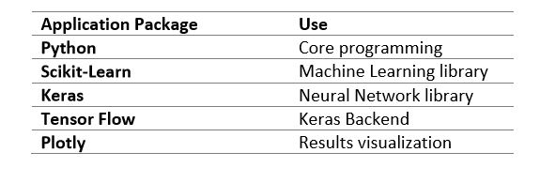
Design Methodology & Implementation
The Design steps were implemented using the following packages:

Slide 8
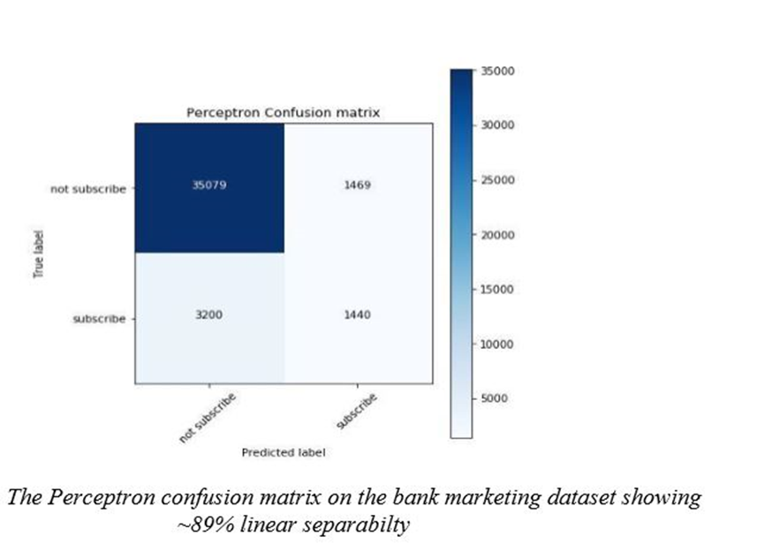
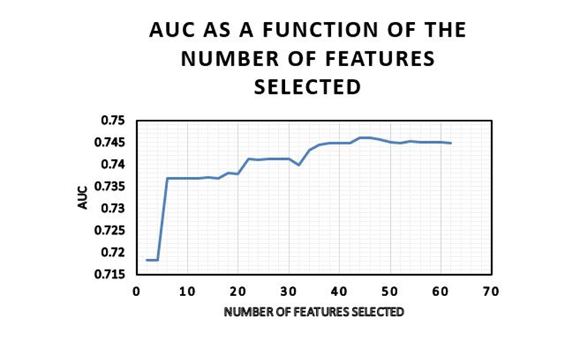
Experimental Results
Linear Separability Results
Following the application of the perceptron algorithm on the bank marketing dataset. The confusion matrix shown below was obtained.
Sequential Forward Search Results for the Logistic Regression Model
The graph above shows the optimum feature subset is consists of the top 46 features.
Notes:
All the results obtained from my presentation are not presented. Results with the core message of the work undertaken are presented.
Perceptron is know to converge is a dataset is linearly separable, In this case its is not entirely separable However, a separability of 89% is achieved

Slide 9
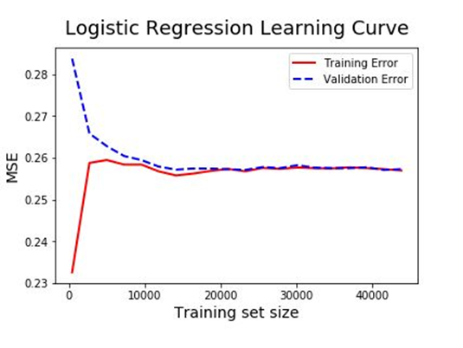
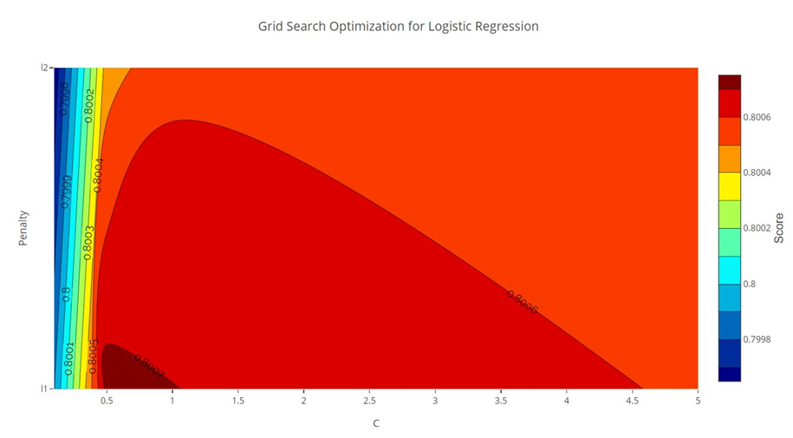
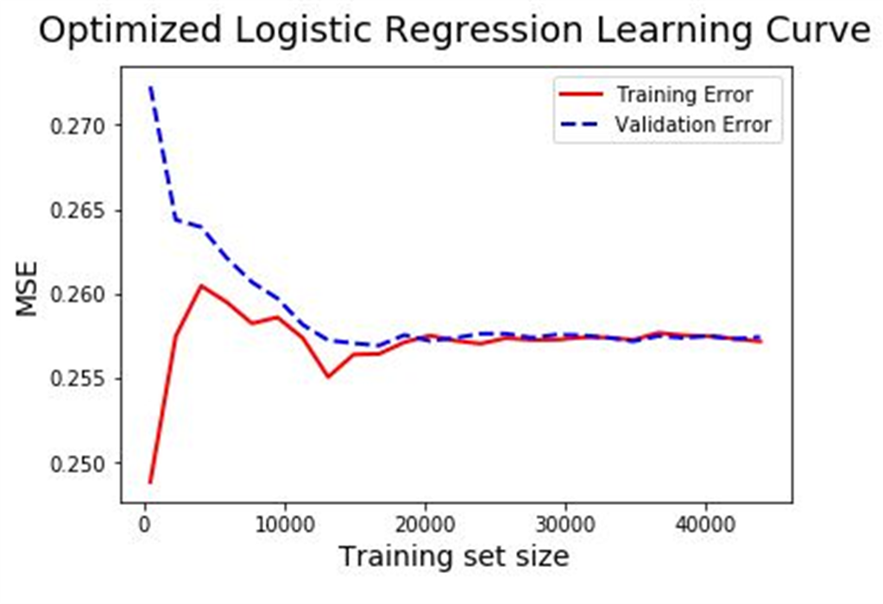
Experimental Results for Parametric Methods
Initial & final generalization performance assessment of the Logistic Regression model
Grid-Search Contour Plot for the selection of optimal parameters.

Slide 10
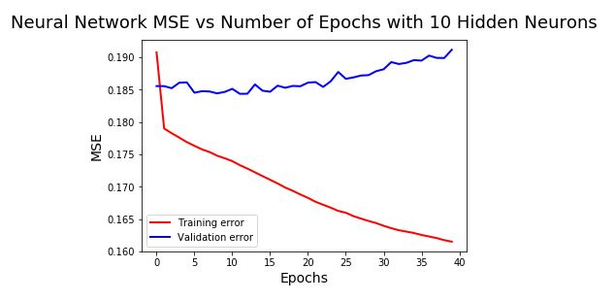
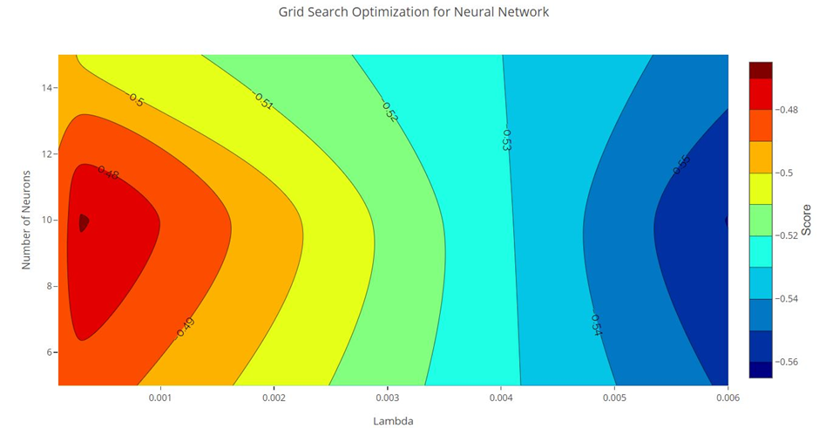
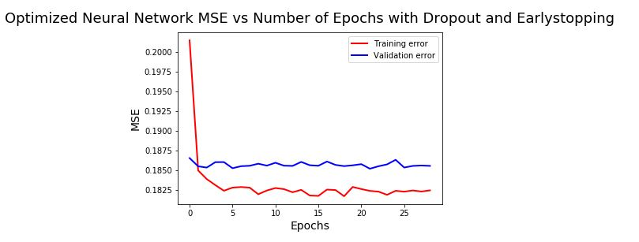
Experimental Results for Non-Parametric Methods
Initial & final generalization performance assessment of the Multilayer Perceptron model
Grid-Search Contour Plot for the selection of optimal parameters.

Slide 11
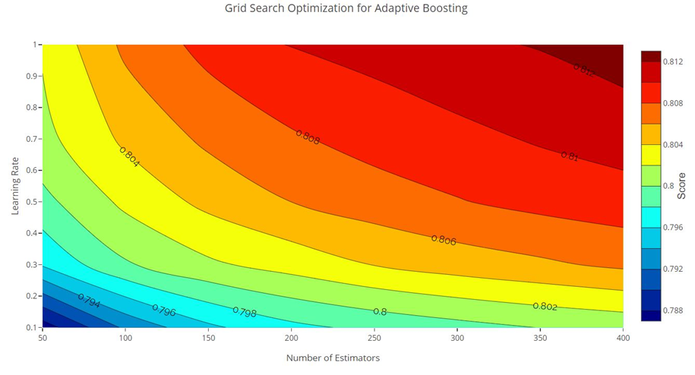
Experimental Results for the AdaBoost
Grid-Search Contour Plot for the selection of optimal parameters
A total of 400 Decision Tree estimators were sequentially combined to boost the performance of the initial DT.
Analysis of the grid-search optimization shows the AUC is likely to increase with greater number of estimators in the ensemble
Limited due to training computation complexity and thus, computational time

Slide 12
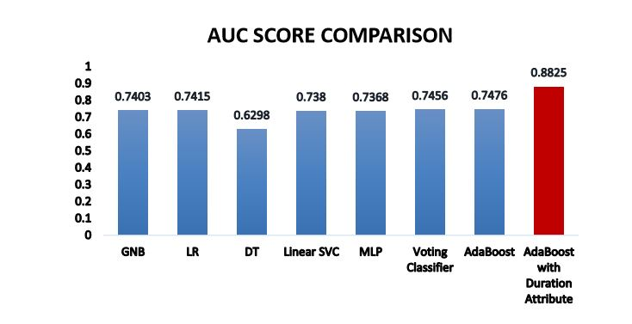
Test Set Performance Comparison
Logistic Regression obtained the highest AUC (0.7415) for the parametric classifiers
Linear SVC obtained the highest AUC (0.738) for the non-parametric classifiers
AdaBoost attained the highest AUC overall (0.7476) – improving the AUC performance of the Decision tree by approximately 19%

Slide 13
Conclusions
Conclusions
Parametric classifiers performed slightly better than the non-parametric methods even after regularization as a result of better generalisation to unseen instances.
The ensemble methods do indeed improve upon the performance of the individual classifiers with the Adaptive Boosting classifier achieving an AUC of 0.7476 with only priori information. No benchmark available for comparison.
With posterior information included for comparison purposes, the AdaBoost achieved an AUC score of 0.8825, ranking 3rd place (5% from first place) amongst the surveyed literature which evaluated against the AUC metric and included posterior information.

Slide 14
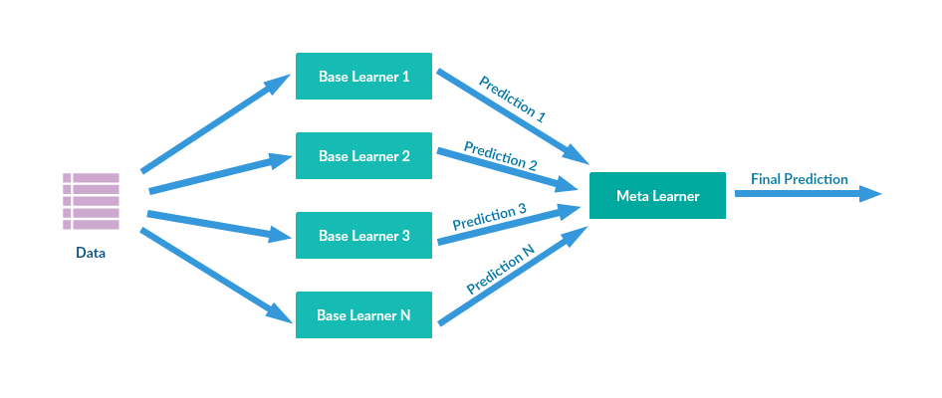
Further Work
Further Optimization of the AdaBoost classifier to improve its performance
Inclusion of the Neural Network into the Voting Classifier to further improve the performance of the Voting Classifier
Use of Weighted Voting technique for the Voting Classifier
Application of other Boosting techniques such as Stacking
Stacking Ensemble Method
Image adopted from Supun Setunga

Slide 15
ANY QUESTIONS?

